Slide 1
EECS 453 Final Project Presentation
Joseph Lynch (lynchjo, 11442632)
Link to Recording:
https://youtu.be/T0vU4-qSvDE

Slide 2
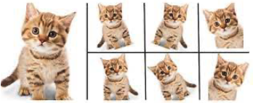
Problem Definition
Data augmentation is a powerful tool for image segmentation and classification tasks and can improve training efficacy and model generalizability¹
There are countless augmentation methods from simple geometric transformation to normalization and even intentionally adding noise
In this project I sought out the answer to the following: “What data augmentation methods (or combination of methods) is most effective?”
Lecture 2, slide 92
Notes:
Add a comment on why

Slide 3
Methods
Part 1: Create 10 different data augmentation techniques from scratch: Part 2: Write a UNET model to classify samples from the MNIST dataset
that have been augmented
All work was done in python using NumPy and Random for creating the listed augmentation. PyTorch was used to create the model and dataloaders
1. | Horizontal Flip | 6. | Crop and Paste
2. | Vertical Flip | 7. | Gaussian Blur
3. | Rotation | 8. | Gaussian Noise
4. | Perspective Shift | 9. | Adjust Sharpness
5. | Crop | 10. | Adjust Brightness

Slide 4
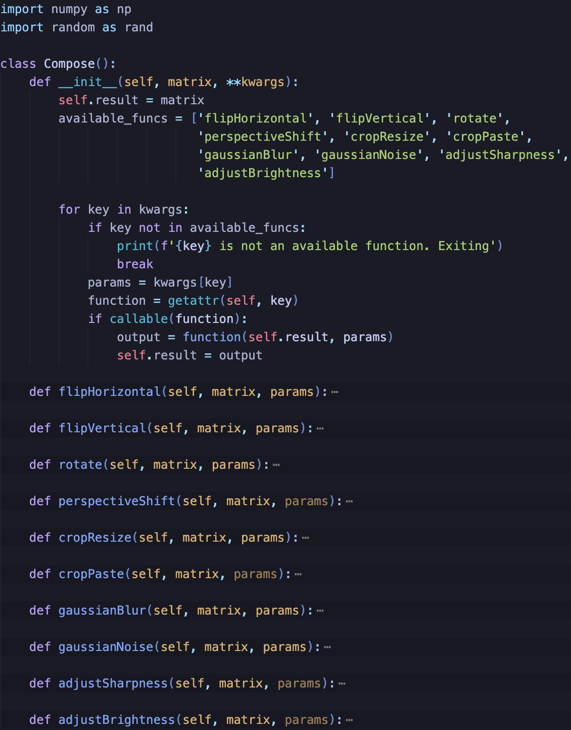
Methods – Augmentations
Augmentation techniques were classified into two categories: geometric and pixel-based.
All augmentations were defined as methods with a “Compose” class that allows a user to apply any combination of the augmentations sequentially to an input image
Commentary:
- There was a wide range of difficulty in creating the
different augmentations
Notes:
talk about perspectiveShift and writing my own convolution function in the commentary section

Slide 5
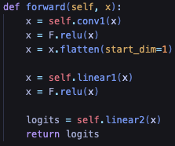
Methods – The Model
The model built had a 2D convolution layer followed by 2 linear layers. The ReLu activation function was used between each layer
The model built differs from the one described in the method...
- Use case
- Computational resources

Slide 6
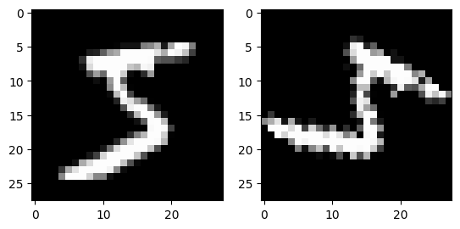
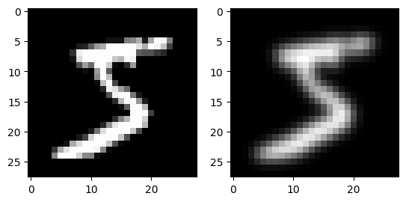
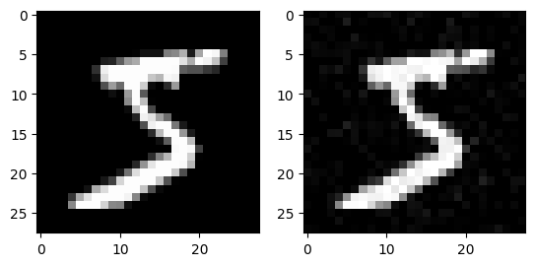
Methods – Training
The following compositions of augmentations were used to train the model on 1000 MNIST samples:
A random 90/10 training/validation split was used for the training dataset. Training was run for 25 epochs.
After each epoch, the model was evaluated on a 1000 sample test dataset.
Geometric 1 | Vertical flip, horizontal flip, rotate
Geometric 2 | Perspective shift, crop+resize, crop+paste
Pixel 1 | Gaussian noise, adjust brightness, Gaussian blur
Pixel 2 | Adjust sharpness, adjust brightness, Gaussian Noise
Mixed 1 | Vertical flip, horizontal flip, Gaussian Noise, crop+resize
Mixed 2 | Rotate, perspective shift, adjust sharpness, adjust brightness
Mixed 3 | Gaussian blur, rotate, crop+resize

Slide 7
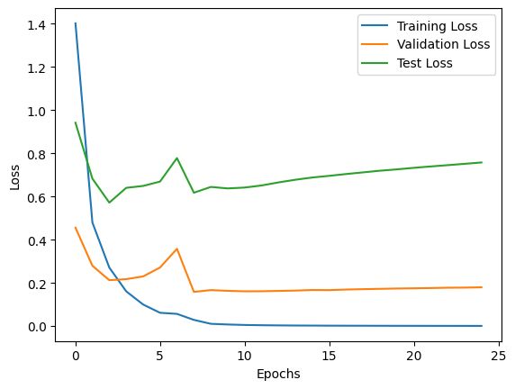
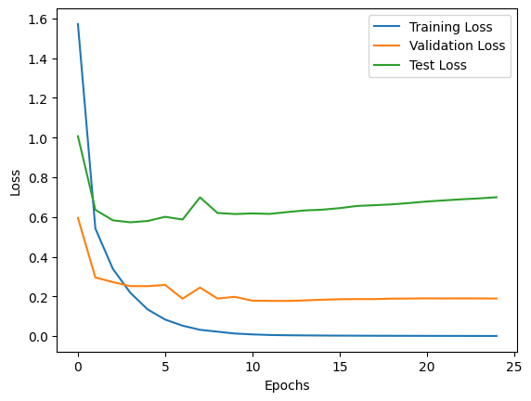
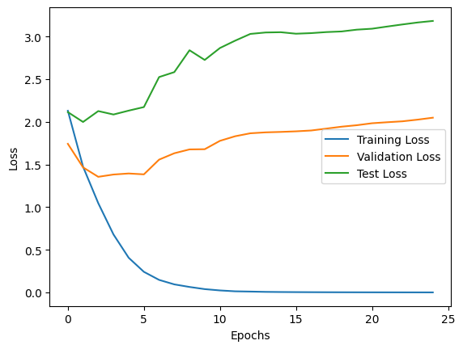
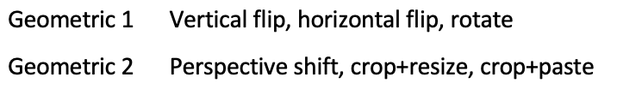
Results – Model Performance
Unaugmented
Geometric 1
Geometric 2
Min test loss: 0.58 @ epoch 3
Min test loss: 0.59 @ epoch 3
Min test loss: 2.03 @ epoch 2

Slide 8
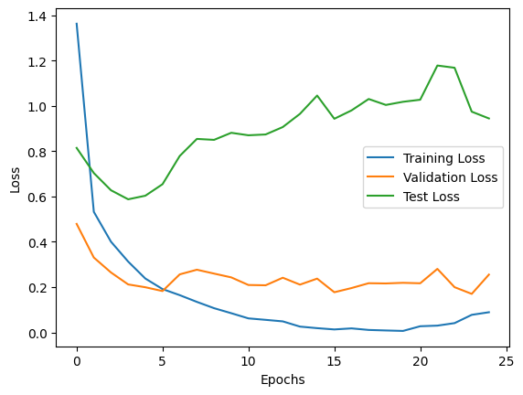
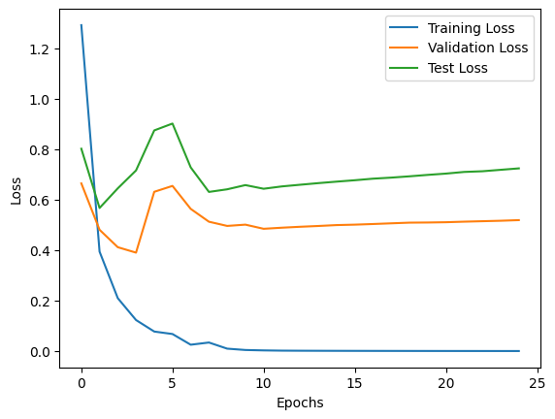
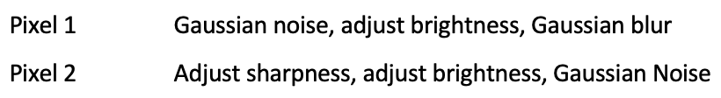
Results – Model Performance
Unaugmented
Pixel 1
Pixel 2
Min test loss: 0.58 @ epoch 3
Min test loss: 0.59 @ epoch 3
Min test loss: 0.58 @ epoch 2

Slide 9
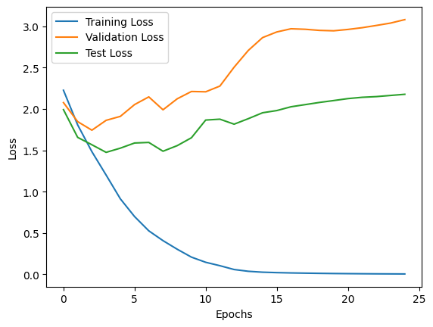
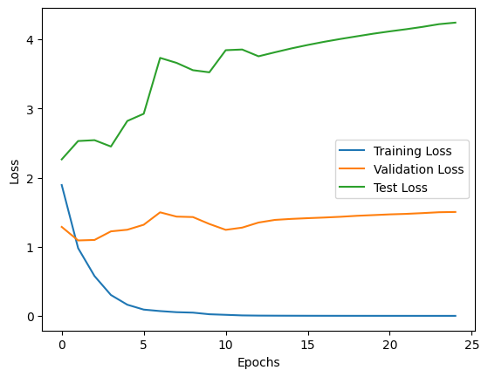
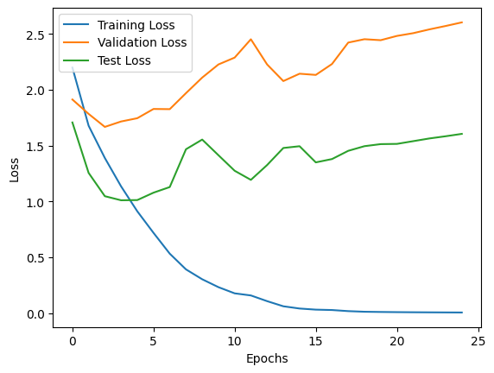
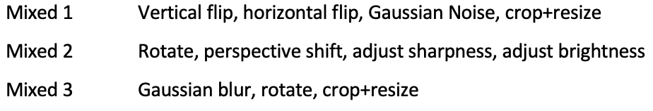
Results – Model Performance
Mixed 1
Mixed 2
Mixed 3
Min test loss: 1.50 @ epoch 3
Min test loss: 2.31 @ epoch 1
Min test loss: 1.03 @ epoch 4

Slide 10
Results – Challenges and Limitations
Aforementioned deviation from planned model architecture
Creating datasets is labor intensive
- augmentations applied beforehand a new images are saved
Limited number of augmentations

Slide 11
Discussion
The best performing augmentation compositions were the pixel-based methods and Geometric 1.
None of the compositions performed better than unaugmented training with only Pixel 2 equaling the unaugmented performance.
The mixed compositions performed the worst by a significant margin

Slide 12
Bibliography
1. Shorten, C., Khoshgoftaar, T.M. A survey on Image Data Augmentation for Deep Learning. J Big
Data 6, 60 (2019). https://doi.org/10.1186/s40537-019-0197-0
2. Ronneberger, O., Fischer, P., & Brox, T. (2015). U-net: Convolutional networks for biomedical
image segmentation. In Medical image computing and computer-assisted intervention–
MICCAI 2015: 18th international conference, Munich, Germany, October 5-9, 2015,
proceedings, part III 18 (pp. 234-241). Springer International Publishing.
3. Deng, L. (2012). The mnist database of handwritten digit images for machine learning research.
IEEE Signal Processing Magazine, 29(6), 141–142.
4. Kiran Maharana, Surajit Mondal, Bhushankumar Nemade, A review: Data pre-processing and
data augmentation techniques, Global Transitions Proceedings, Volume 3, Issue 1, 2022,
Pages 91-99, ISSN 2666-285X, https://doi.org/10.1016/j.gltp.2022.04.020.
5. A. Mikołajczyk and M. Grochowski, "Data augmentation for improving deep learning in image
classification problem," 2018 International Interdisciplinary PhD Workshop (IIPhDW),
Świnouście, Poland, 2018, pp. 117-122, doi: 10.1109/IIPHDW.2018.8388338. keywords:
{Image color analysis;Machine learning;Lesions;Image classification;Neural
networks;Cancer;Task analysis;Machine learning;style transfer;data augmentation;deep
learning;medical imaging},
6. Ronneberger, O., Fischer, P., & Brox, T. (2015). U-net: Convolutional networks for biomedical
image segmentation. In Medical image computing and computer-assisted intervention–
MICCAI 2015: 18th international conference, Munich, Germany, October 5-9, 2015,
proceedings, part III 18 (pp. 234-241). Springer International Publishing.
7. Paszke, A., Gross, S., Massa, F., Lerer, A., Bradbury, J., Chanan, G., … Chintala, S. (2019). PyTorch:
An Imperative Style, High-Performance Deep Learning Library. In Advances in Neural
Information Processing Systems 32 (pp. 8024–8035). Curran Associates, Inc. Retrieved from
http://papers.neurips.cc/paper/9015-pytorch-an-imperative-style-high-performance-deep-
learning-library.pdf
8. Pauli Virtanen, Ralf Gommers, Travis E. Oliphant, Matt Haberland, Tyler Reddy, David
Cournapeau, Evgeni Burovski, Pearu Peterson, Warren Weckesser, Jonathan Bright, Stéfan J.
van der Walt, Matthew Brett, Joshua Wilson, K. Jarrod Millman, Nikolay Mayorov, Andrew R.
J. Nelson, Eric Jones, Robert Kern, Eric Larson, CJ Carey, İlhan Polat, Yu Feng, Eric W. Moore,
Jake VanderPlas, Denis Laxalde, Josef Perktold, Robert Cimrman, Ian Henriksen, E.A.
Quintero, Charles R Harris, Anne M. Archibald, Antônio H. Ribeiro, Fabian Pedregosa, Paul
van Mulbregt, and SciPy 1.0 Contributors. (2020) SciPy 1.0: Fundamental Algorithms for
Scientific Computing in Python. Nature Methods, 17(3), 261-272. DOI: 10.1038/s41592-019-
0686-2.

